Slide 1

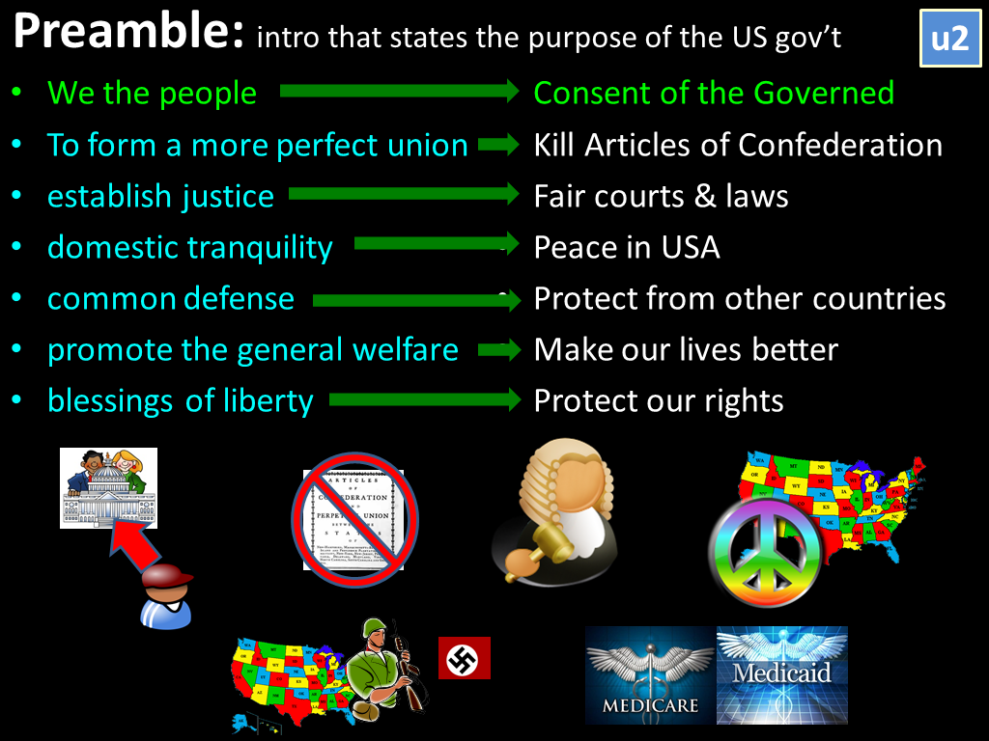
Make Laws
Enforce Laws
Interpret Laws

Slide 3

- 435 Representatives
- Based on Population
- 100 Senators
- 2 per State

Slide 4
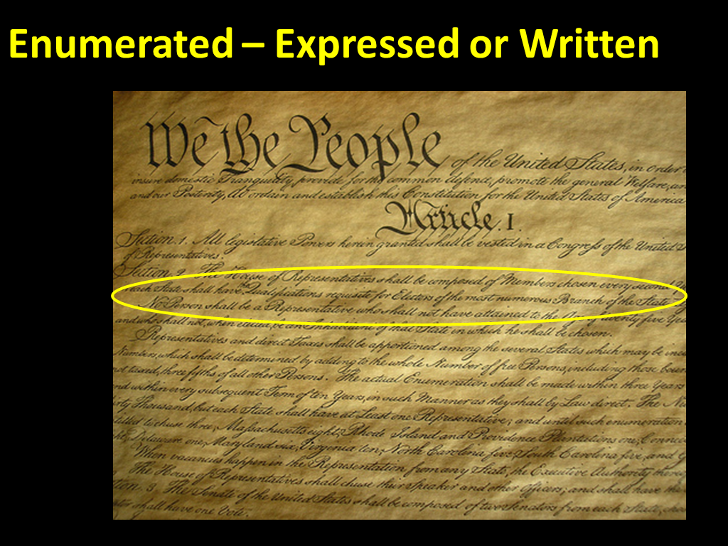
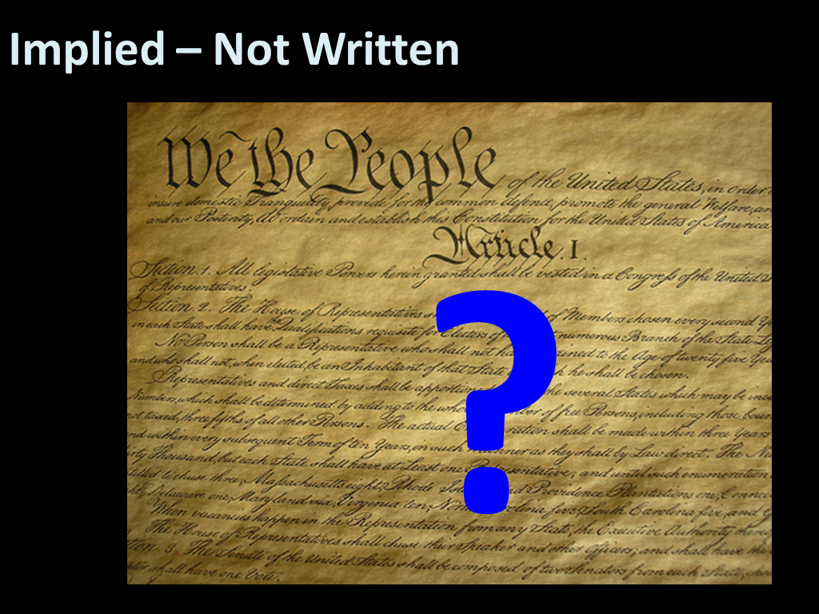

Slide 5
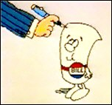
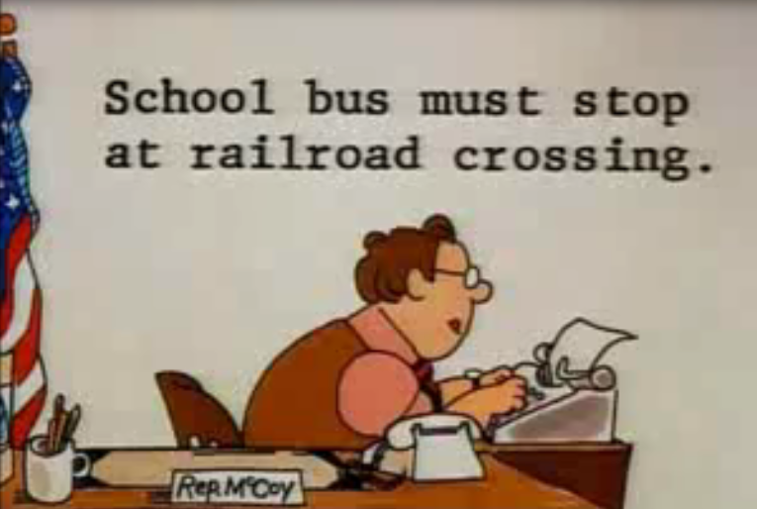
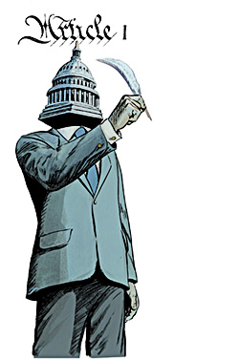
Write Laws

Slide 6

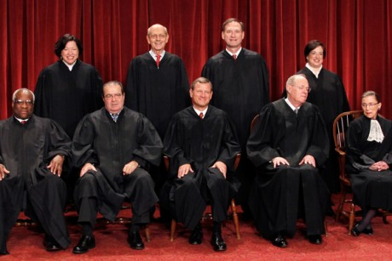
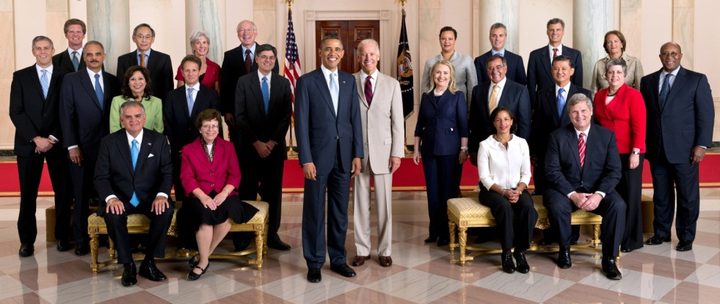
US Budget
Income | 2.5 trillion
Military | -900 billion
Social Security | -730 billion
Medicaid | -500 billion
Medicare | -300 billion
Gov’t Costs | -500 billion
Other | -600 billion
Total | -1.27 trillion
L
Approves
Cabinet

Slide 7

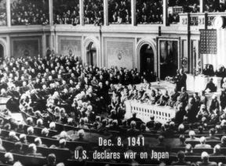

Create Taxes
Declare War

Slide 8
Legislative
Make Laws
Approves Budget
  final say of gov’t spending
Approves Appointments
  Final say on who becomes a judge or cabinet member
Create Taxes
Declare War

Slide 10

Executive Branch
President
Vice President

Slide 11
Executive Branch
Cabinet

Slide 12
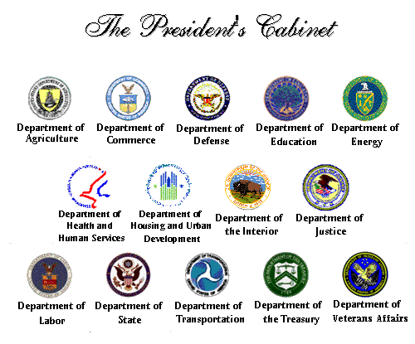

Slide 13
Public Policy
Policy
  The government’s plan on what to do in the US

Slide 14

Government should NOT help the poor, people should help themselves
Government should help the poor

Slide 15
President Influences Policy or Gov’t Plan
State of the Union speech
  Asks for new laws
Appeals to the People on TV
  “we the people…”
Appoints officials to carry out laws

Slide 16
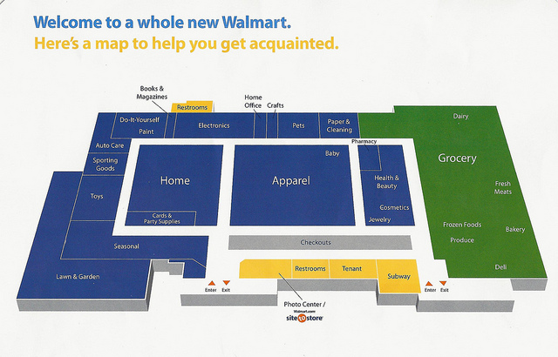
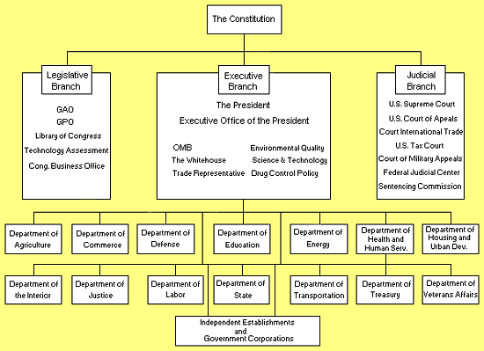
Federal Bureaucracy – Runs the gov’t

Slide 18

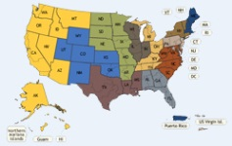


Dual Court System
-Federal
-State
Rare
Supreme Court
US Circuit Court of Appeals
US District Court

