Slide 1
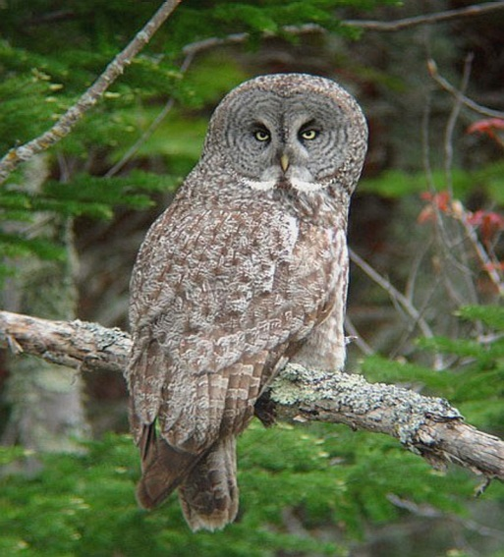
THE MALICAN PARTY
Liberal:
Death penalty
Economy
Global Warming
Conservative:
Abortion
Gun Control
Private Property
Same Gender Marriage

