Slide 1
Public
Goods
$$$
Day 6
free
Exclusive
Non-Exclusive
1
rivalrous
many
Non-Rivalrous

Slide 2
Public Goods
vs.
Private Goods

Slide 3
Public Goods
Something anyone can use & we can use at the same time
Excludable
vs.
Non-Excludable
- Not everyone can use it
- Usually because price
- Everyone can use it
- Usually Free
Rivalrous
vs.
Non-Rivalrous
- Only one can use it
- Many can use at once

Slide 4
Public Goods
Shoes are not a public good
Shoes are a private good
  They are Excludable
    If you want shoes, you have to pay for them
  They are Rivalrous
    Only one person can wear a pair of shoes at a time

Slide 5
$$$
free
Exclusive
Non-Exclusive
Shoes
Fishing grounds
rivalrous
Cheeseburger
Pasture
Few Benefit
rivalrous
Cars
Wild-life
Movie Theater
Schools
Many benefit
Amusement Park
Roads
Non-Rivalrous
non-rivalrous
Golf Course
Military

Slide 6
Public Goods
Schools
Roads
Military
Police
Firefighters
Fireworks
Radio
Public parks
Lighthouse
Library
FEMA
Snow Plows
Taxes

Slide 7

No Public Goods
Jones
Johnson
Roberts
Smith
Hodges

Slide 8
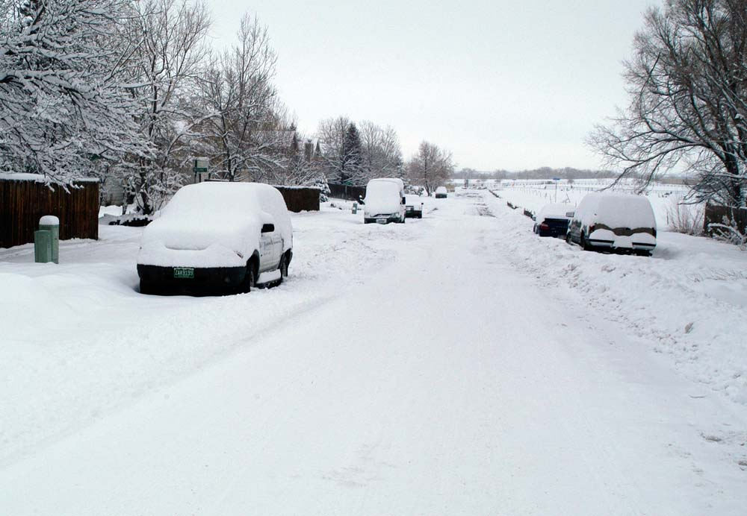
No Public Goods

Slide 9
No Public Goods
Jones
Johnson
Roberts
Smith
Hodges

Slide 10
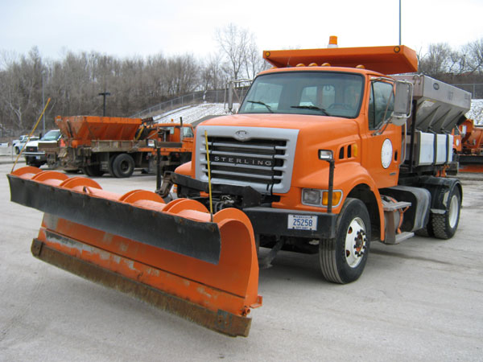
No Public Goods
$100

Slide 11

No Public Goods
Jones
Johnson
Roberts
Smith
Hodges

Slide 12
No Public Goods
Jones
Johnson
Roberts
Smith
Hodges

Slide 13
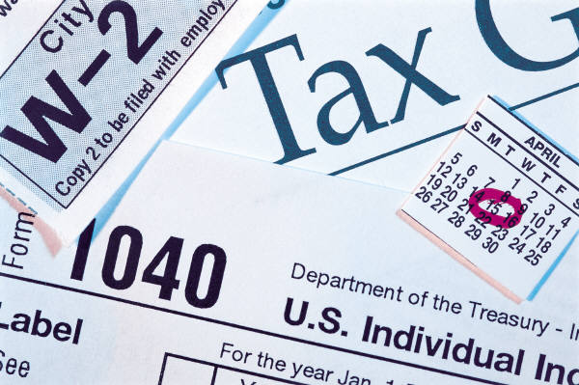
No Public Goods
Free Riders
  How do we make sure everyone pays???
  TAXES

Slide 14

Public Goods
FCHS needs a new school building
  Taxes
If no taxes, people would have to pay
Some people wouldn’t pay, and there kids would still use the school
  Freeriders!

Slide 15
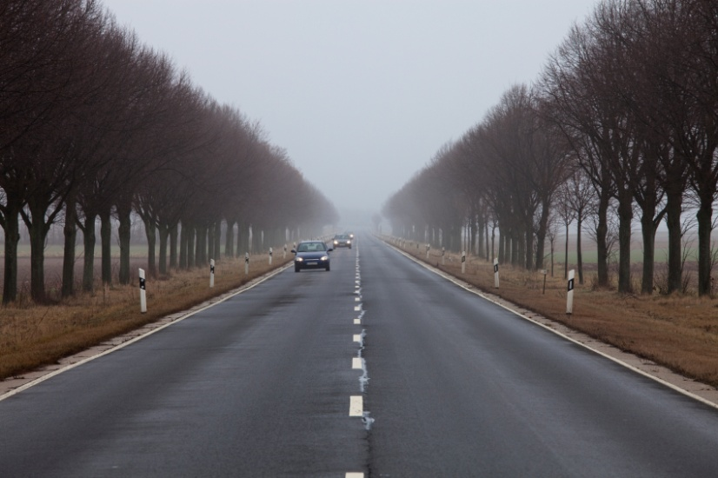
Public Goods
Highway to Blacksburg from Rocky Mount
  Taxes
If no taxes, people have to pay
Some people wouldn’t pay, and would still use the road
  Freeriders!

Slide 16

Public Good
Something that benefits many people at the same time,
and anyone can use it

Slide 17
$$$
free
Exclusive
Non-Exclusive
3 pics
3 pics
1
rivalrous
3 pics
5 pics of
Public
Goods
many
Non-Rivalrous

