Slide 1

Unit 2
History/creation
Of the US Gov‘t
Unit 3
US Gov‘t
How it works

Slide 3
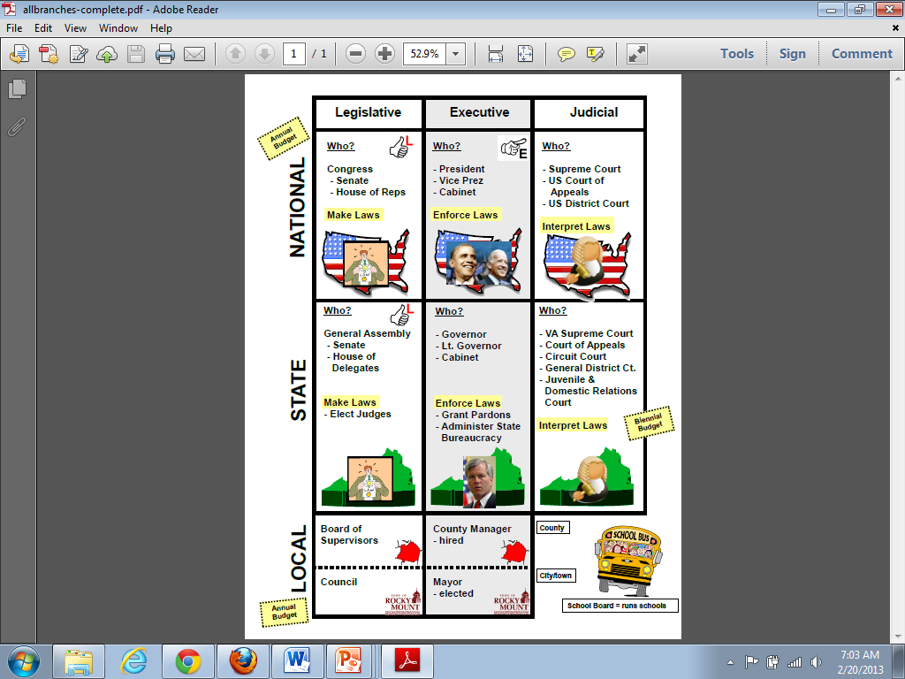
Separation of Powers
Federalism

Slide 4
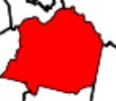
Federalism – Power Flows Down
POWER
POWER
POWER

Slide 5
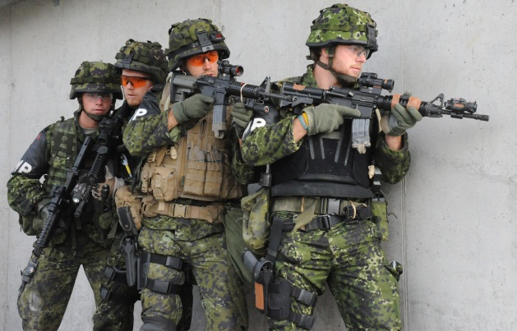
Federalism – division of power between state & nat’l gov’t
POWER
POWER
POWER
national
state

Slide 7
Makes Laws

Slide 8

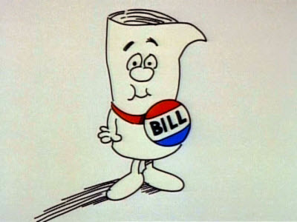
Makes Laws

Slide 9
Enforces Laws

Slide 10




Enforces Laws

Slide 11
Interprets Laws

Slide 12
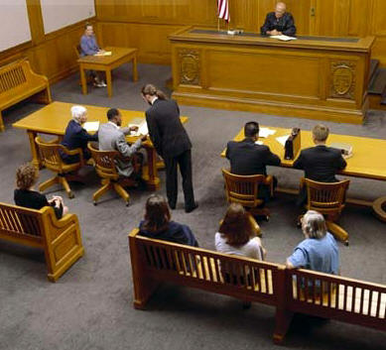
Interprets Laws

Slide 13
Makes Laws
Enforces Laws
Interprets Laws

Slide 14



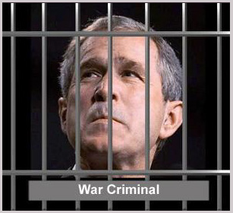
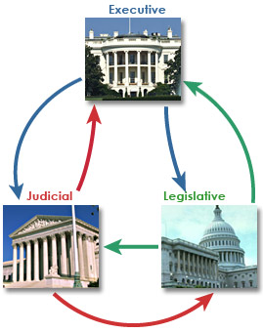



u2
Fundamental Political Principles
Consent of the Governed
Representative
Government
Representative
Government
Limited Government
Rule of Law
We pick people to vote for us
People are
The source of power
Democracy
Gov’t cannot do anything it wants
No one is above the law
People rule thru voting

Slide 15
Legislative Branch
1 representative for every 700,000 citizens
11
2
lower
upper
100
435

Slide 16
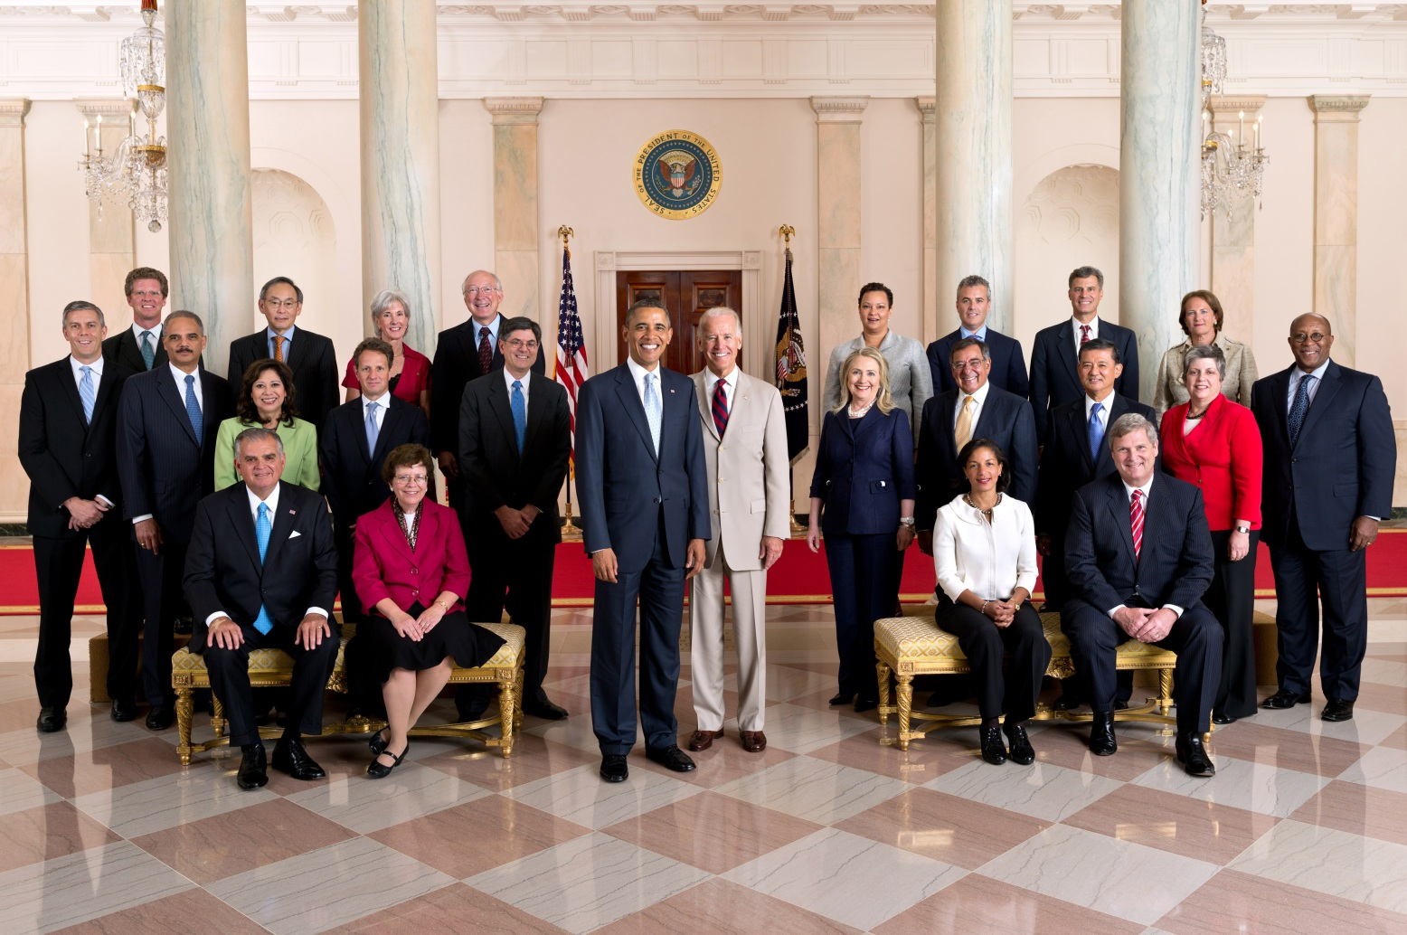
Executive Branch
President
Vice President

Slide 17
Executive Branch
Cabinet

Slide 18
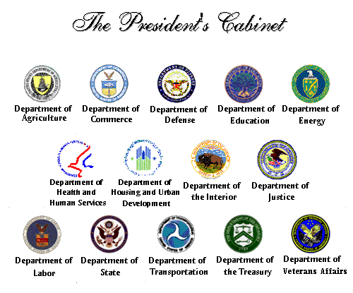

Slide 19
Executive Branch
Cabinet
Education
Defense
Treasury
quitting
quitting
Transportation
State

Slide 20

Judicial Branch
What is an appeal?

Slide 21

Judicial Branch
9
Supreme
Court
US Circuit Court
Of Appeals
US District Court

