Slide 1
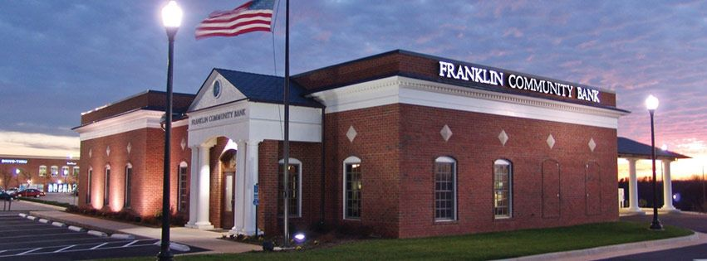

Why put money in a Bank?
interest
=
amount money grows over time

Slide 2

Banks
$1000
3%
bank
depositor
$1030

Slide 3

Banks
$1000
$1000
6%
3%
borrower
bank
depositor
$1060
$1030
Profit: $30

Slide 4
Banks
Option #1 (safe):
  Only lend to people you know will pay the loan back
  Opportunity Cost:
    Will not make a lot of money
Option #2 (risky):
  Loan money to people that may not pay it back
  Opportunity Cost:
    Safety

Slide 5
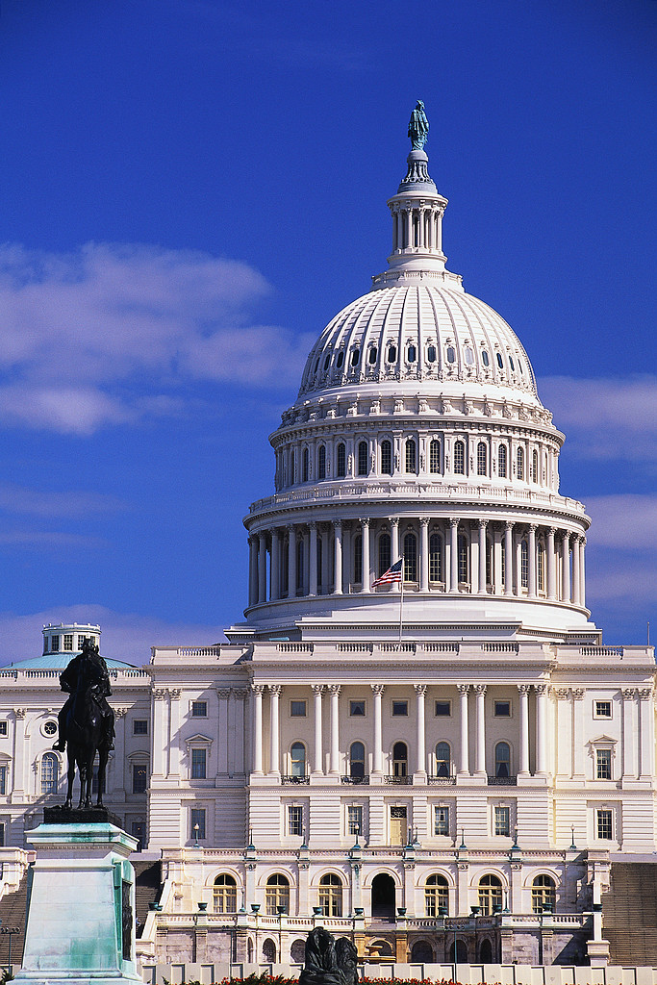
Banks
$20,000
$10,000
10%
2%
bank
1000 borrowers
1000 depositors
$20,200,000
$10,200,000
$10 mil.

Slide 6
What if…
Borrowers do not pay back their loans?
2008 Economic Crisis

Slide 7
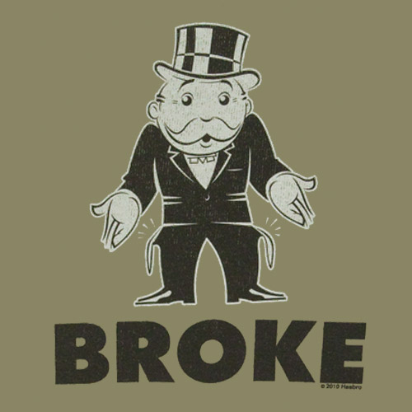
Banks
1000 borrowers
$20,000
$10,000
10%
2%
bank
1000 depositors
$0
$20,200,000
$10,200,000
$-10.2 million
$0
$10 mil.

Slide 8

Biggest Problem
Banks loan money to new businesses
New businesses create jobs
No Banks = No Jobs
BANK

Slide 9






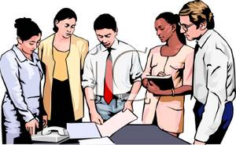
BANKS

Slide 10

Who is to blame?

Slide 11
Who is to blame?
Borrowers that did not pay back their loans?
The Banks for making bad loans?

Slide 12

Who did the US gov’t help?
Borrowers or Banks?

Slide 13

The Government helped the Banks
and millions of people lost their homes

Slide 14

The 2008 Financial Crisis
Small Bank

Slide 15
The 2008 Financial Crisis
Borrowers
Small Banks

Slide 16

Investors & Pension Plans
Want something to invest in
Housing has always been safe
The 2008 Financial Crisis

Slide 17
The 2008 Financial Crisis
Big
Bank
Small Banks
Borrowers

Slide 18

Big
Bank
The 2008 Financial Crisis

Slide 19



Global
investor
The 2008 Financial Crisis
Home
Loans
Big
Bank
Bigger
Bank

Slide 20

global
investors
The 2008 Financial Crisis
bigger bank
big bank
Small bank

Slide 21

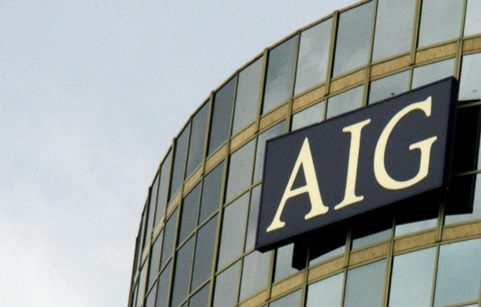
insurance
global
investors
Home
Loans
The 2008 Financial Crisis
If people pay the house loan…I make money
If people do not…insurance will pay me money

Slide 22
Home
Loans
The 2008 Financial Crisis
It is worth NOTHING!
It’s a Toxic Asset
Small Bank

Slide 23
insurance
Home
Loans
global
investors
The 2008 Financial Crisis

Slide 24
The 2008 Financial Crisis
Bankrupt

Slide 25
global
investors
insurance
bigger bank
big bank
Home
Loans
Small bank

Slide 26
BANKS

Slide 27
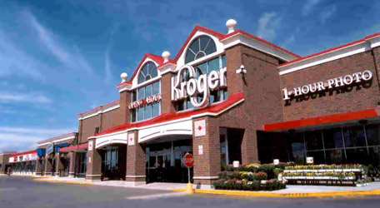
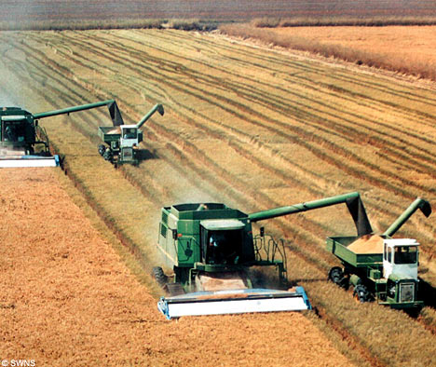
Can’t buy food
Citizens can’t buy food
Can’t pay bills
Farmer doesn’t have money to run farm = no food

Slide 28
The 2008 Financial Crisis
Bankrupt

