Slide 1
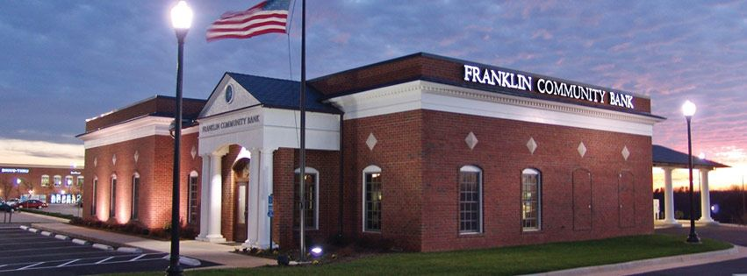
Bank Game

Slide 2
Bank Game
2-3 players
You open a Bank to make more money
  When you loan money you earn money from interest
The Bank that makes the most good loans wins

Slide 3
Bank Game
Each round a new person will ask for a loan.
Based on the information, each competing bank will decide whether to loan to the person or not
  Some people are good loan candidates, and you will make money when they pay their loan off
  Some people will not pay their loan, and you will lose money
On separate sheets of paper # the page 1-15, secretly write yes or no for each round
At the end, check your answers

Slide 4
Simon S.
1
Simon needs $100,000 to open his pie making business. Simon has worked in the restaurant business his whole life. It is obvious that Simon is a good cook and very dedicated, but it remains in question if Simon can manage a business. It is also questionable if a pie business can be successful.

Slide 5
Don and Sherry
2
Don and Sherry have found their dream house. They need $200,000. They are in their mid-twenties and do not have an unordinary amount of debt. Sherry is an Registered Nurse and makes $70k/year. Don is a construction worker, but has been out of work for a year. They also have an 18 month old baby.

Slide 6

Linda
3
Linda needs $35k to buy a new Lexus. She needs a new car because she totaled her previous car. Linda is a pretty successful beautician and makes $29k/year.

Slide 7
Jimmy
4
Jimmy needs $150k to buy a home. Jimmy is married and has two kids. Jimmy works as a mechanic and makes $33k a year. Jimmy’s credit score is not very good and he has sizeable credit card debt. His wife is unemployed, and both of their children have expensive medical conditions.

Slide 8
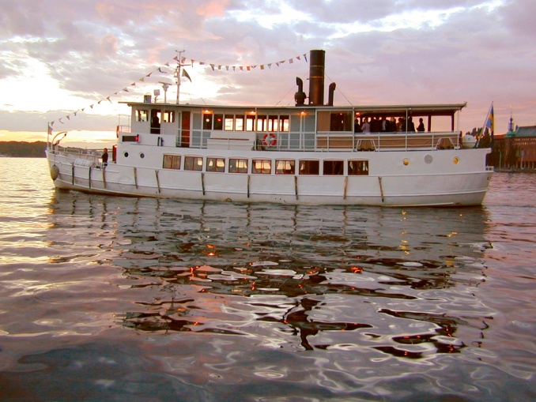
Leonard
5
Leonard would like to borrow $250k to buy a boat. Leonard has a good credit score. He pays all of his bills on time, but they are mostly small bill payments. Leonard does not have a credit card and does not own a house. He is 22 years old. This would be his first major purchase.

Slide 9

Jen
6
Jen needs $70k to attend Virginia Tech. Jen plans on studying literature. Her parents are both teachers and cannot afford to pay for Jen’s college (most parents cannot). Jen has a job working for Parks and Rec in the summers.

Slide 10
Susan
7
Susan needs $70k to attend Virginia Tech. Susan plans on majoring in engineering. Her parents are unemployed and cannot afford to pay for Jen’s college (most parents cannot). Susan has never had a job because she played school sports year round.

Slide 11

Rick and Joyce
8
Rick and Joyce needs $100k to pay for their daughters tuition at Virginia. Their daughter plans on majoring in accounting. Rick is a plumber ($40k/year) and Joyce is a lawyer ($60/year). The couple has a large amount of debt with credit cards and house payments. However, Joyce did pay off her law school debt in a timely manner.

Slide 12
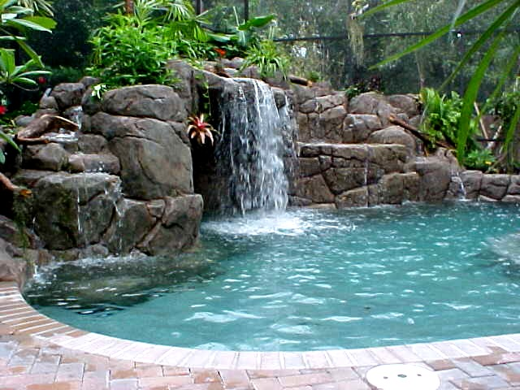
J.J.
9
J.J. wants to build a swimming pool in his backyard. He needs $100,000. J.J. is single and in his mid-thirties. J.J. and earns $55k/year as a pharmacuetical salesman. J.J. is currently paying loans for his car, his house, and his college education. He makes all of his payments on time.

Slide 13

Steve
10
Steve is a new pilot he would like a loan for $10k to buy a used car. Steve has over $100k in college debt that he owes to another bank. Steve only makes $20k/year, and has an average amount of credit card debt.

Slide 14
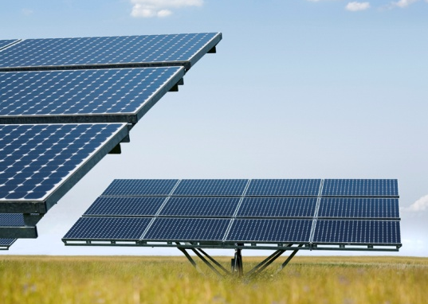
Bill
11
Bill has been an engineer for 15 years. He recently invented a new design for solar panels. He would like to start a business building and selling solar panels. He needs a $250k loan. Bill is very smart, but his experience is in engineering, not business. Bill is married, has one child, and very little debt.

Slide 15
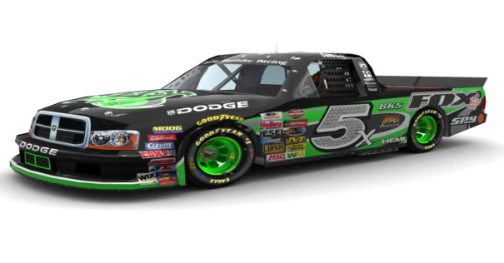
Ronnie
12
Ronnie has been a mechanic for 40 years. He owns his shop and has been very successful. Ronnie’s children are all grown up and he does not have any debt. In fact, Ronnie has enough money saved up to retire comfortably with is wife. However, Ronnie’s lifelong dream is to run a Nascar Team. Ronnie has $250k saved up, but he another $250k to get started in the Nascar truck series.

Slide 16
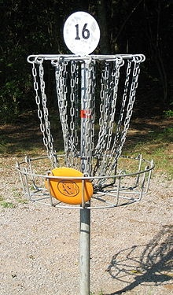
Henry
13
Henry would like to build a Frisbee golf course at the middle school. He needs $15k to buy the equipment and to hire workers to build it. The course will be free to use, but Henry plans on making money buying selling all of the different discs. Henry has never operated a business, but Frisbee golf is becoming very popular. Henry is a principal ($55k/year) and has an average amount of debt. His wife is a nurse ($30k/year).

Slide 17
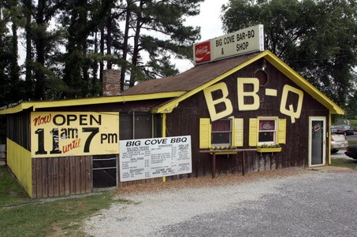
Sally
14
Sally was recently laid off from her job at the factory. She is having trouble finding a job. She has decided to start her own business. She wants to start a BBQ restaurant. She needs $200,000. Her husband works for VDOT ($50k/year). They have two young children. Besides their house payment, they do not have much debt.

Slide 18
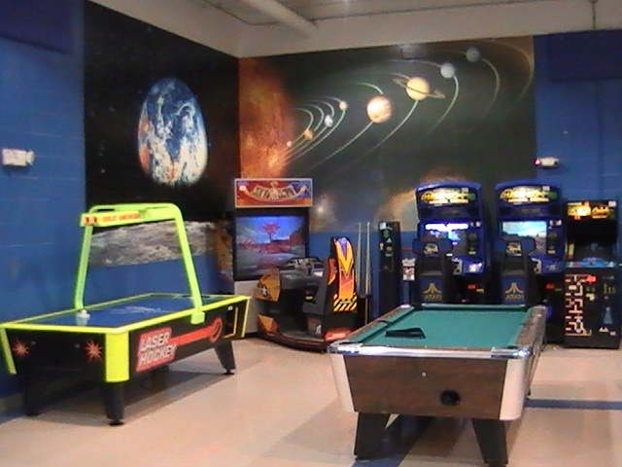
Nick
15
Nick is a youth minister. He is 25 years old. He would like to build a youth center for teens to hang out in a safe environment. Nick is still in school finishing his theology degree. Nick owes another bank a lot of money for his college loans. Nick knows very little about construction, but he is very enthusiastic and seems like a genuine person. Nick believes he can raise $50k through his church, but he needs another $250k from the bank.

Slide 19
The End
Check your answers with the next slides to see who has the best bank

Slide 20
Simon S.
1
Simon needs $100,000 to open his pie making business. Simon has worked in the restaurant business his whole life. It is obvious that Simon is a good cook and very dedicated, but it remains in question if Simon can manage a business. It is also questionable if a pie business can be successful.
Does NOT pay back loan. 90% Restaurants go out of business.

Slide 21
Don and Sherry
2
Don and Sherry have found their dream house. They need $200,000. They are in their mid-twenties and do not have an unordinary amount of debt. Sherry is an Registered Nurse and makes $70k/year. Don is a construction worker, but has been out of work for a year. They also have an 18 month old baby.
pay back loan. Sherry has a solid job.

Slide 22
Linda
3
Linda needs $35k to buy a new Lexus. She needs a new car because she totaled her previous car. Linda is a pretty successful beautician and makes $29k/year.
Does NOT pay back loan. The car is too expensive for her.

Slide 23
Jimmy
4
Jimmy needs $150k to buy a home. Jimmy is married and has two kids. Jimmy works as a mechanic and makes $33k a year. Jimmy’s credit score is not very good and he has sizeable credit card debt. His wife is unemployed, and both of their children have expensive medical conditions.
Does NOT pay back loan. Too much debt. Too many expenses.

Slide 24
Leonard
5
Leonard would like to borrow $250k to buy a boat. Leonard has a good credit score. He pays all of his bills on time, but they are mostly small bill payments. Leonard does not have a credit card and does not own a house. He is 22 years old. This would be his first major purchase.
Does pay back loan, but he has to sell the boat and takes a loss.
Good for the bank, bad for Lenny.

Slide 25
Jen
6
Jen needs $70k to attend Virginia Tech. Jen plans on studying literature. Her parents are both teachers and cannot afford to pay for Jen’s college (most parents cannot). Jen has a job working for Parks and Rec in the summers.
Does NOT pay back loan because she is unable to get a job with her literature major.

Slide 26
Susan
7
Susan needs $70k to attend Virginia Tech. Susan plans on majoring in engineering. Her parents are unemployed and cannot afford to pay for Jen’s college (most parents cannot). Susan has never had a job because she played school sports year round.
Does pay back loan because he is able to get a job with his academic major.

Slide 27
Rick and Joyce
8
Rick and Joyce needs $100k to pay for their daughters tuition at Virginia. Their daughter plans on majoring in accounting. Rick is a plumber ($40k/year) and Joyce is a lawyer ($60/year). The couple has a large amount of debt with credit cards and house payments. However, Joyce did pay off her law school debt in a timely manner.
pay back loan.

Slide 28
J.J.
9
J.J. wants to build a swimming pool in his backyard. He needs $100,000. J.J. is single and in his mid-thirties. J.J. and earns $55k/year as a pharmacuetical salesman. J.J. is currently paying loans for his car, his house, and his college education. He makes all of his payments on time.
Does not pay back loan. He has too many expenses.

Slide 29
Steve
10
Steve is a new pilot he would like a loan for $10k to buy a used car. Steve has over $100k in college debt that he owes to another bank. Steve only makes $20k/year, and has an average amount of credit card debt.
Does pay back loan. A used car is a smart decision.

Slide 30
Bill
11
Bill has been an engineer for 15 years. He recently invented a new design for solar panels. He would like to start a business building and selling solar panels. He needs a $250k loan. Bill is very smart, but his experience is in engineering, not business. Bill is married, has one child, and very little debt.
Does NOT pay back loan. Bill is a great engineer, but he knows nothing about running a business.

Slide 31
Ronnie
12
Ronnie has been a mechanic for 40 years. He owns his shop and has been very successful. Ronnie’s children are all grown up and he does not have any debt. In fact, Ronnie has enough money saved up to retire comfortably with is wife. However, Ronnie’s lifelong dream is to run a Nascar Team. Ronnie has $250k saved up, but he another $250k to get started in the Nascar truck series.
Does NOT pay back loan. Nascar is too risky. In a split second your car wrecks and you can lose it all.

Slide 32
Henry
13
Henry would like to build a Frisbee golf course at the middle school. He needs $15k to buy the equipment and to hire workers to build it. The course will be free to use, but Henry plans on making money buying selling all of the different discs. Henry has never operated a business, but Frisbee golf is becoming very popular. Henry is a principal ($55k/year) and has an average amount of debt. His wife is a nurse ($30k/year).
Does pay back loan. It’s a small loan. The bank doesn’t make much money from this loan.

Slide 33
Sally
14
Sally was recently laid off from her job at the factory. She is having trouble finding a job. She has decided to start her own business. She wants to start a BBQ restaurant. She needs $200,000. Her husband works for VDOT ($50k/year). They have two young children. Besides their house payment, they do not have much debt.
Does NOT pay back loan. Small Restaurants do not last!

Slide 34
Nick
15
Nick is a youth minister. He is 25 years old. He would like to build a youth center for teens to hang out in a safe environment. Nick is still in school finishing his theology degree. Nick owes another bank a lot of money for his college loans. Nick knows very little about construction, but he is very enthusiastic and seems like a genuine person. Nick believes he can raise $50k through his church, but he needs another $250k from the bank.
Does NOT pay back loan. He is in way over his head.

