Slide 1
Executive Branch
Checks and Balances
Interest Groups

Slide 2
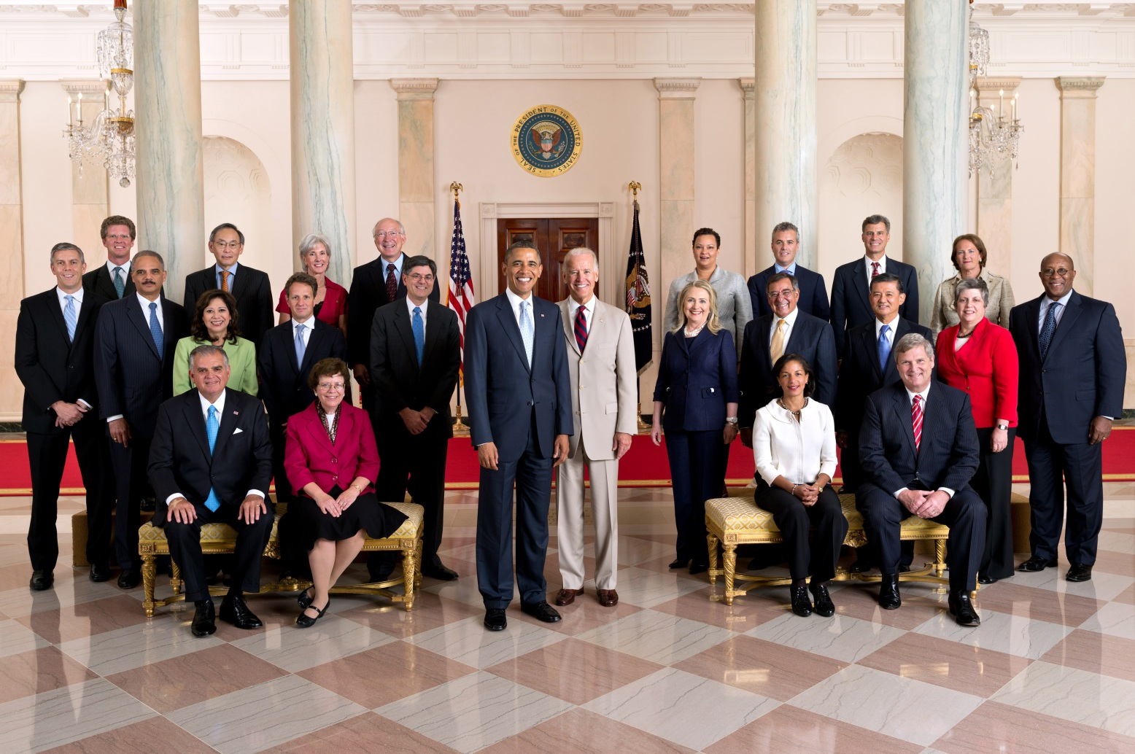
Executive Branch
President
Vice President

Slide 3
Executive Branch
Cabinet

Slide 4
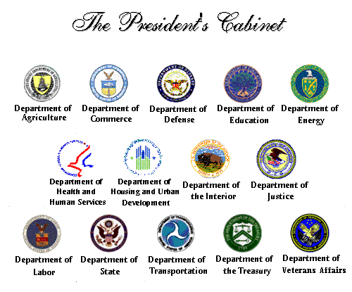

Slide 5
Executive Branch
Cabinet
Education
Defense
Treasury
quitting
quitting
Transportation
State

Slide 6

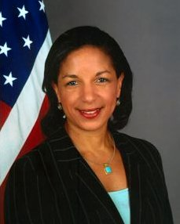
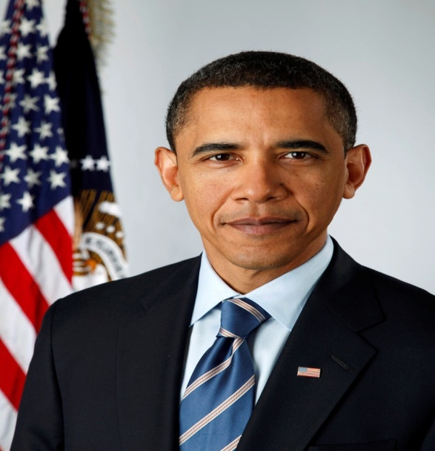
Checks and Balances
E
Secretary of State
Susan Rice
President

Slide 7
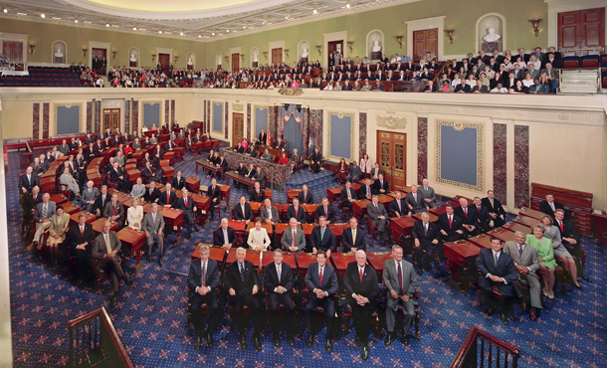

Checks and Balances
Limited
Government
L
The Senate

Slide 8
Checks and Balances
E
Secretary of State
Susan Rice
President
L
Senate

Slide 9
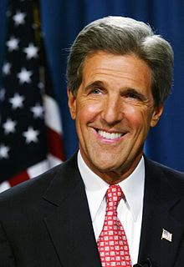
Checks and Balances
E
Secretary of State
John Kerry
President
L
Senate

Slide 10
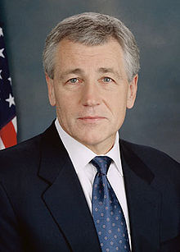
Checks and Balances
E
Defense Secretary
Chuck Hagel
President

Slide 11
Checks and Balances
L
The Senate

Slide 12
Checks and Balances
E
Defense Secretary
Chuck Hagel
President
?
L
Senate

Slide 13
Republican Chuck Hagel
Good
Bad
Vietnam War Veteran
Former US Senator
Virginian
Against war in middle east
Opposes interest groups
CEO of a Voting machine co.
Won election (major upset)
Former Lobbyist
Accused of being anti-Semitic

Slide 14

Interest Groups
Definition: have a belief, use political power to make the belief law or policy
What they want (their beliefs):
US should give money to Israel (Jewish holy land)
US should be tough on Israel’s enemies (Iran)
How they get it:
Bribe politicians (pay for campaigns)
Attack politicians they can’t bribe
  http://www.chuckhagel.com/

Slide 15
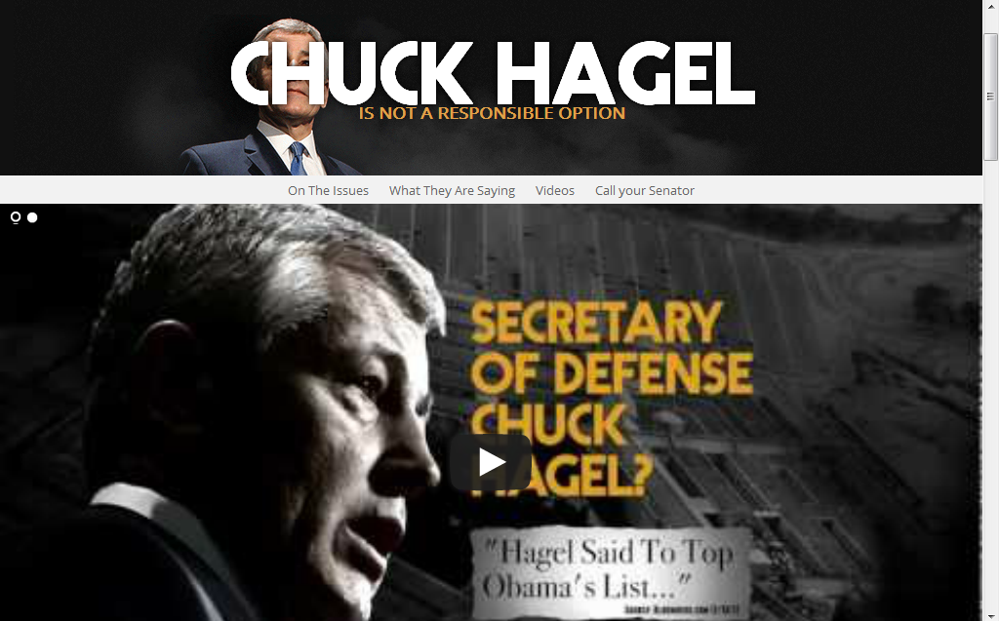

Slide 16
L
L
Senate

Slide 17
Dual Court System
Appellate
Original
Federal
Virginia
Special Cases
Judicial Review
Supreme Court
Marbury v. Madison
Special Cases
Va Supreme Court
Circuit Ct of Appeals
Virginia Appeals
US District
Felony
Civil case High $
Felony
Civil Cases
Circuit
Misdemeanor
Civil case low $
Juvenile &
Dom. Relations
General District

Slide 18
US Constitution
Amendments
  1 – Freedom of:
      Religion
      Assembly (gather together)
      Press (publish information)
      Petition (request things from gov’t)
      Speech
  5 – Due Process (national)
  10 – Reserved Powers to the states
  14 – Due Process (state), citizenship
  16 – Taxes
Due Process
Gov’t cannot treat citizens unfairly

Slide 19
Amendments Mini-Mini Posters
5 pieces of Mini-Mini Paper
Each piece is dedicated to one amendment
  Write the amendment
  What is important about the amendment
  Create pictures, art, or designs that apply

