Slide 1
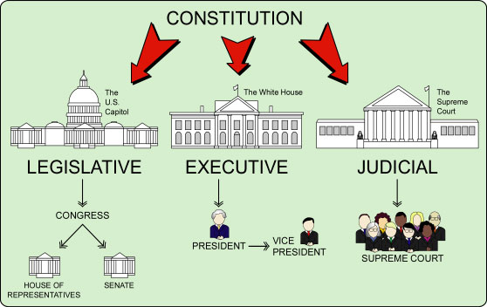

Slide 2
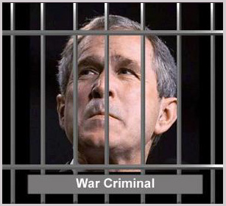
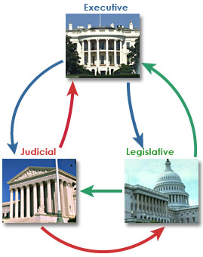
u2
Fundamental Political Principles
Consent of the Governed
Representative
Government
Representative
Government
Limited Government
Rule of Law
We pick people to vote for us
People are
The source of power
Democracy
Gov’t cannot do anything it wants
No one is above the law
People rule thru voting

Slide 3
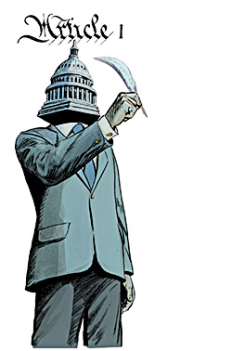

Slide 4
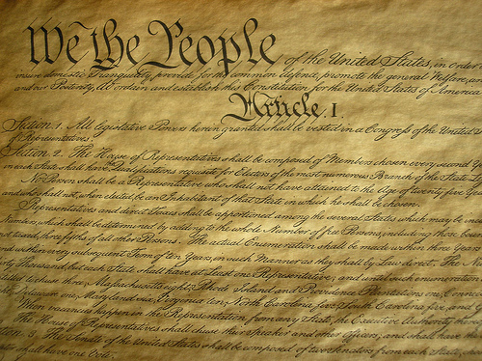

Slide 5
EXPRESSED

Slide 6
IMPLIED
?

Slide 7
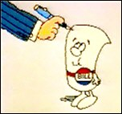
Write Laws

Slide 8
Monthly Budget
Income | 2,500
Rent | -700
Car Payment | -400
TV & Internet | -100
Insurance | -150
Groceries | -500
Utilities | -200
Total | +450
L

Slide 9
US Budget
Income | 2.5 trillion
Military | -900 billion
Social Security | -730 billion
Medicaid | -500 billion
Medicare | -300 billion
Gov’t Costs | -500 billion
Other | -600 billion
Total | -1.27 trillion
L

Slide 10
US Budget
Income | 2.5 trillion
Military | -900 billion
Social Security | -730 billion
Medicaid | -500 billion
Medicare | -300 billion
Gov’t Costs | -500 billion
Other | -600 billion
Total | -1.27 trillion

Slide 11
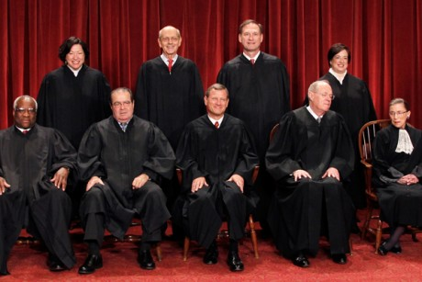
L

Slide 12
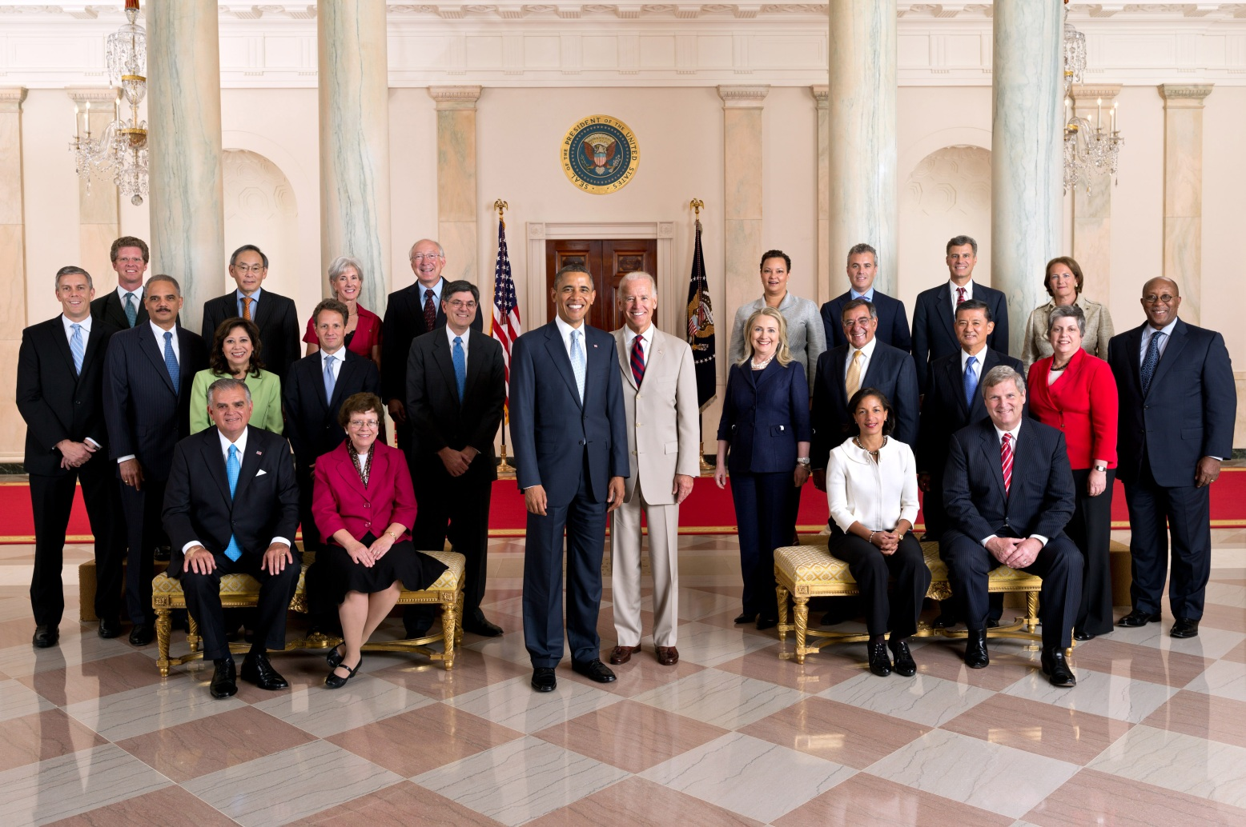
L
Cabinet

Slide 14
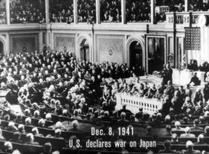
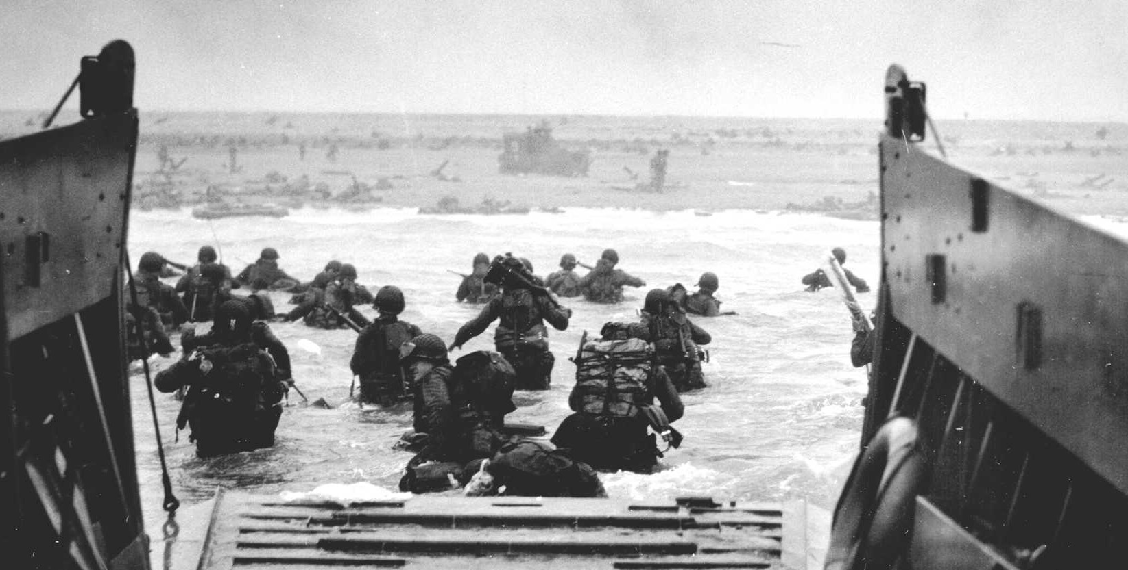
Declare
War

Slide 15
-435 representative
-based on on population
-100 Senators
-2 per state

Slide 16
Big Population states have a lot of power
Small Population states have power
All States must work together

Slide 17
u2
Fundamental Political Principles
Consent of the Governed
Representative
Government
Limited Government
Limited Government
Rule of Law
We pick people to vote for us
People are
The source of power
Democracy
Gov’t cannot do anything it wants
Gov’t cannot do anything it wants
No one is above the law
People rule thru voting

