Slide 1
ARTICLE I: LEGISLATIVE BRANCH
TWO HOUSES: HOUSE OF REPS./ SENATE
HOW MEMBERS FROM EACH HOUSE MUST BE CHOSEN AND WHAT RULES THEY MUST FOLLOW IN MAKING LAWS.
IT ALSO LISTS SPECIFIC POWERS THAT CONGRESS DOES AND DOESN’T HAVE.

Slide 2
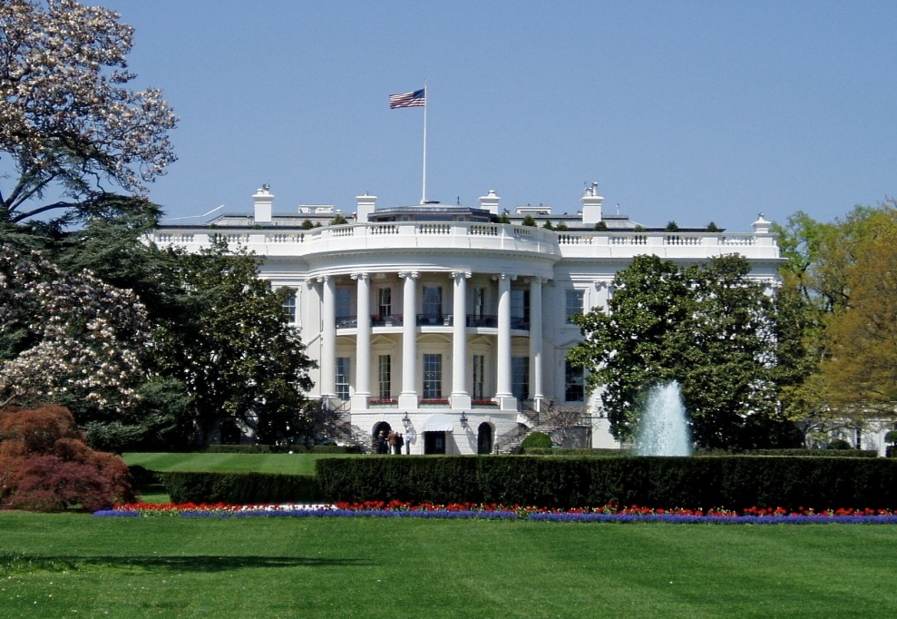
ARTICLE 2:EXECUTIVE BRANCH
HEADED BY PRESIDENT AND VICE PRESIDENT.
DESCRIBES PRESIDENTS POWERS AND DUTIES.

Slide 3
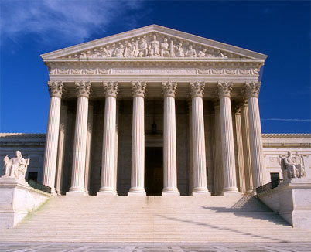
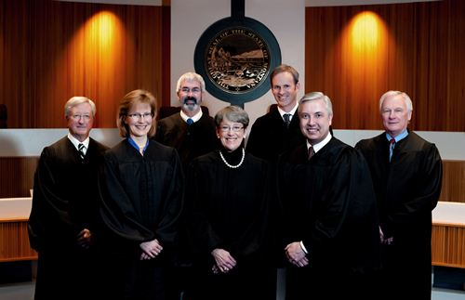
ARTICLE 3:JUDICIAL BRANCH
INTERPRETS LAWS.
LIST THE POWERS OF FEDERAL COURTS AND DESCRIBES THE KINDS OF CASES THEY MAY HEAR
CALLS FOR “ ONE SUPREME COURT”

Slide 4
ARTICLE 4: States
STATES MUST RESPECT EACH OTHERS LAWS, COURT DECISIONS, AND RECORDS
EXPLAINS THE PROCESS FOR CREATING NEW STATES

